Slide 1
분산시스템에서 빅데이터 분석
충남대학교
응용과학계산 연구실
김경섭

Slide 2
연구주제
Machine Learning and Deep-learning
Text mining
Neural network
Distributed computing : Hadoop, Spark
Applied scientific computing : Numerical algorithm, fast algorithm
Applications: signal and image processing, control theory

Slide 3
Applied Scientific Computing Lab
Machine/Deep
Learning
Big Data
Analysis
Optimized and Fast ??
Statistics\
Numerical
Computing
Signal Process
Control problem
……..

Slide 4
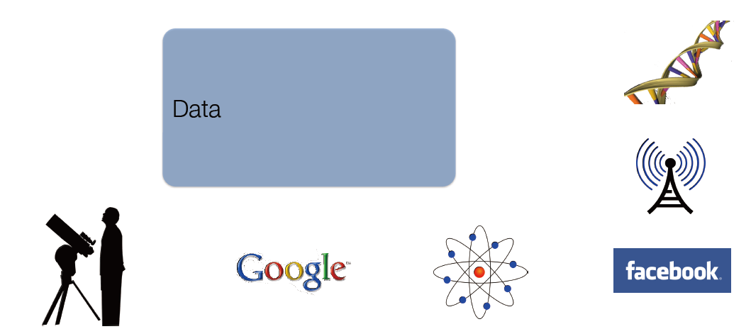
Rapid growth of massive datasets
Online activity, Science, Sensor networks

Slide 5
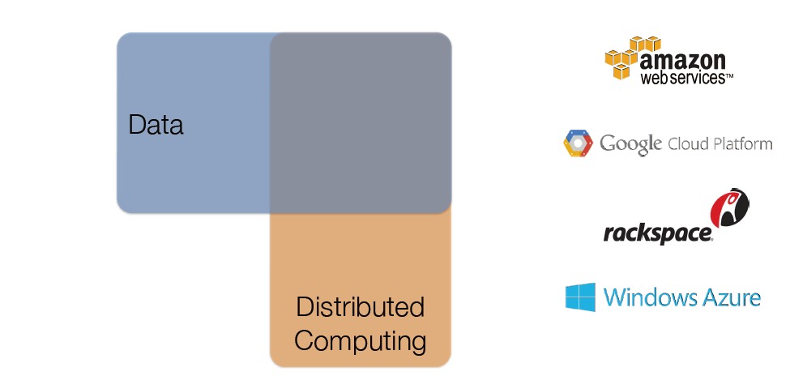
Distributed Clusters are Pervasive

Slide 6
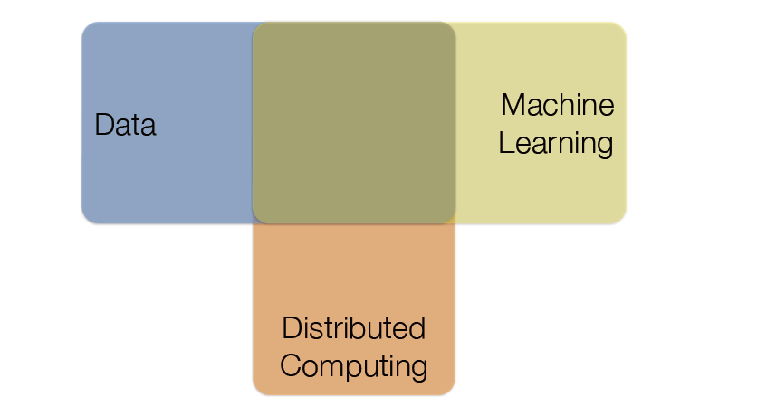
Mature Methods for Common Problems
Machine Learning: classification, regression, collaborative filtering, clustering, deep learning

Slide 7
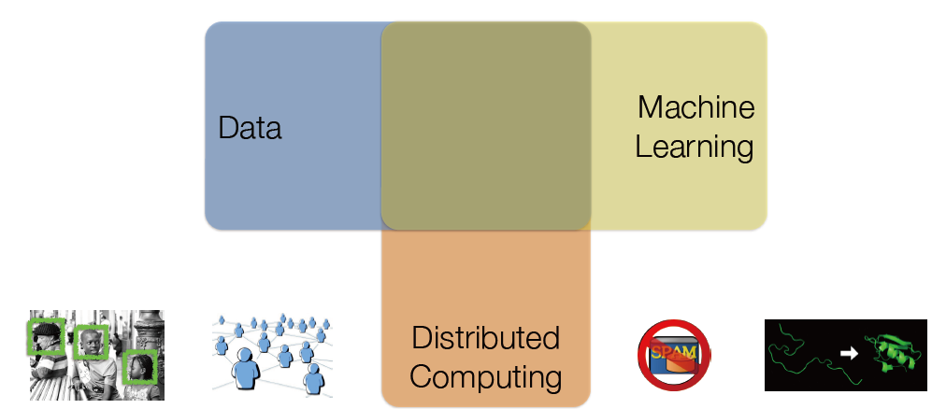

ML applications
Personalized recommendations, Speech recognition, Face detection, Protein structure, Fraud detection, Spam filtering, Playing chess, go, or Jeopardy, Unassisted vehicle control, Medical diagnosis, ...

Slide 8
The Big Data Problem
Traditional Analysis Tools
Unix shell commands, Pandas, R
All run on a single machine!
Data growing faster than computation speeds
Growing data sources
Web, mobile, scientific, …
Storage getting cheaper
Size doubling every 18 months
But, stalling CPU speeds and storage
bottlenecks

Slide 9
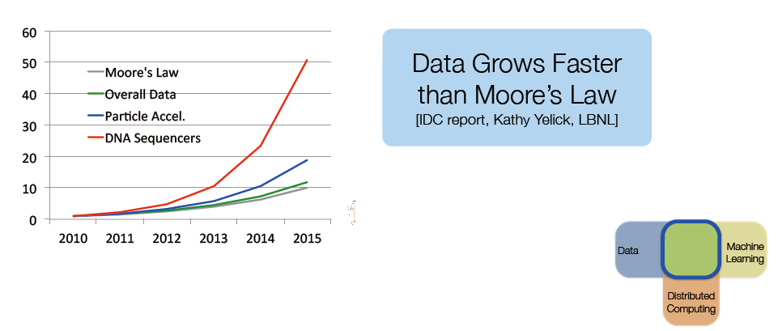
Challenge: Scalability
Classic ML techniques are not always suitable for modern datasets

Slide 10
Big Data Examples
Facebook’s daily logs: 60 TB
1,000 genomes project: 200 TB
Google web index: 10+ PB
Cost of 1 TB of disk: ~$35
Time to read 1 TB from disk: 3 hours
(100 MB/s)

Slide 11
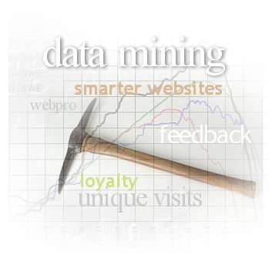
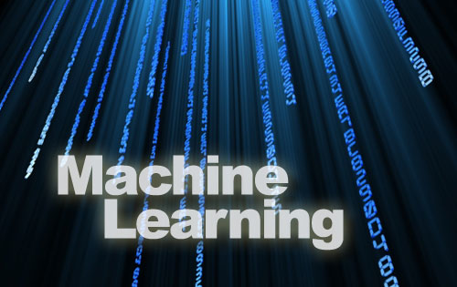

Data Analytics
Include machine learning and data mining tools
Analyze/mine/summarize large datasets
Extract knowledge from past data
Predict trends in future data

Slide 12


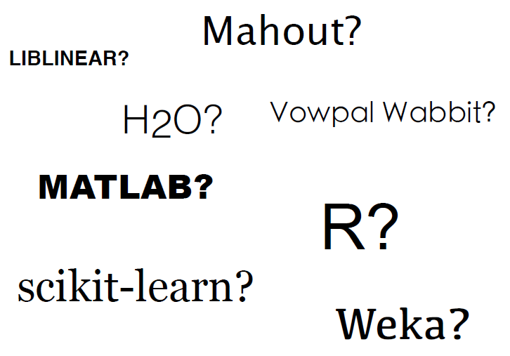

What tool?

Slide 13

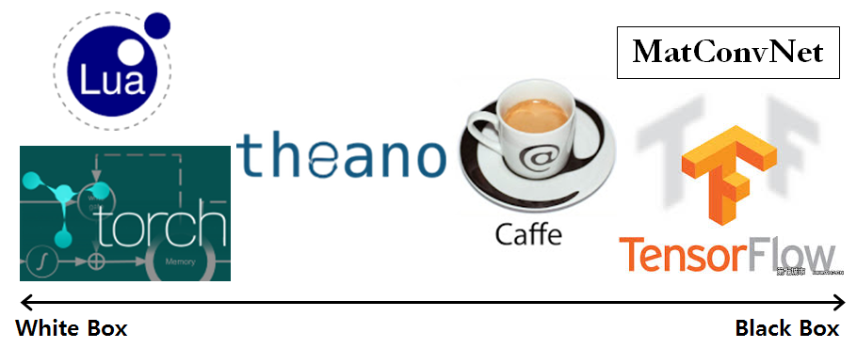
Deep Learning Tools?
MatConvNet
Theano
TensorFlow
Torch
Caffe

Slide 14
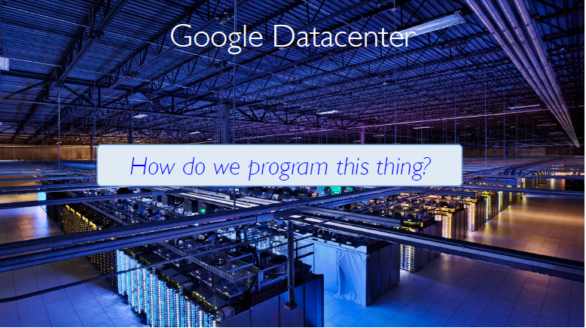
The Big Data Problem
A single machine can no longer process or even store all the data!
Only solution is to distribute data over large clusters

Slide 15
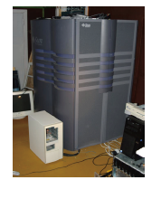
Hardware for Big Data
One big box? (1990’s solution)
But, expensive
Low volume"
All “premium” hardware"
But, still not big enough!!

Slide 16
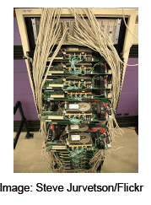
Hardware for Big Data
Consumer-grade hardware
"Not “gold plated”
Many desktop-like servers
"Easy to add capacity"
"Cheaper per CPU/disk"
Complexity in software

Slide 17
Problems with Cheap Hardware
Failures, Google’s numbers
"1-5% hard drives/year"
"0.2% DIMMs/year"
Network speeds versus shared memory
Much more latency"
Network slower than storage
Uneven performance
What’s Hard About Cluster Computing?
How do we split work across machines?"

Slide 18
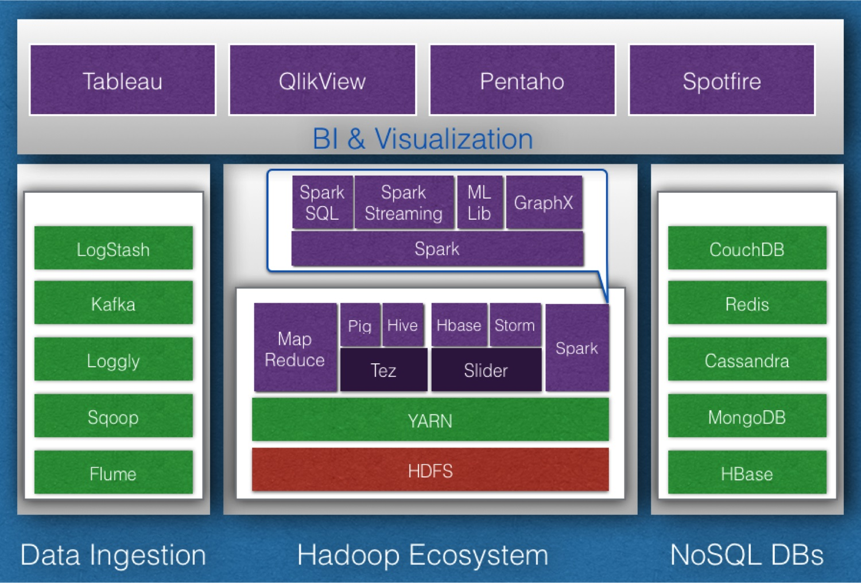
Distributed file system: Hadoop Ecosystem

Slide 19

Applied Scientific Computing Lab
Who uses Hadoop?

Slide 20
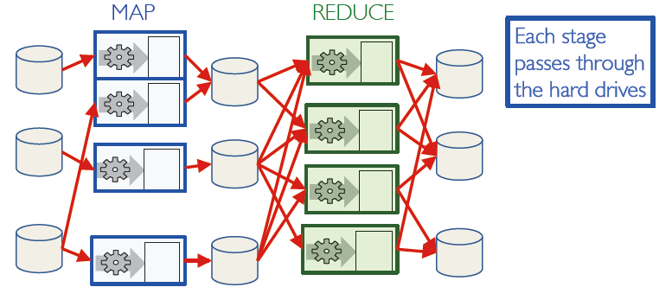
Map Reduce: Distributed Execution

Slide 21
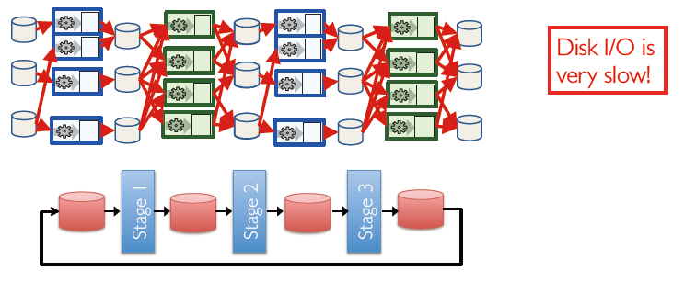
Map Reduce: Iterative Jobs
Iterative jobs involve a lot of disk I/O for each repetition

Slide 22
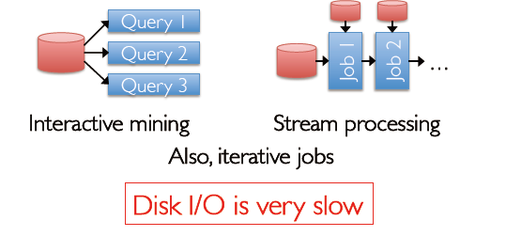
Apache Spark Motivation
Using Map Reduce for complex jobs, interactive queries and online processing involves lots of disk I/O

Slide 23
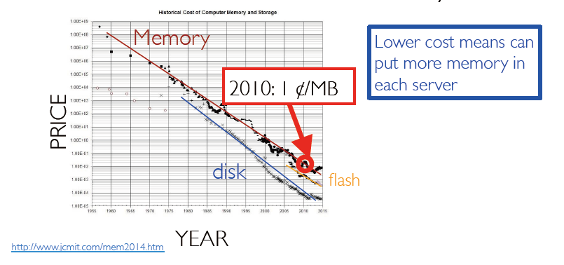
Tech Trend: Cost of Memory

Slide 24
Opportunity
Keep more data in-memory
Create new distributed execution engine

Slide 25
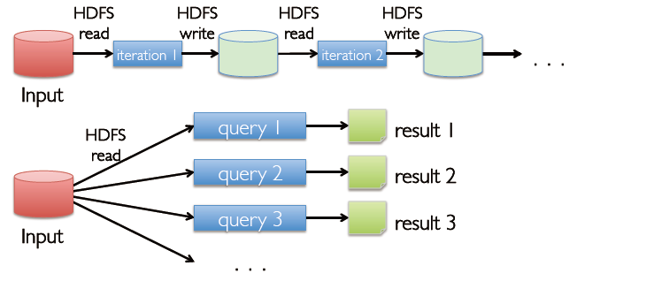
Use Memory Instead of Disk

Slide 26
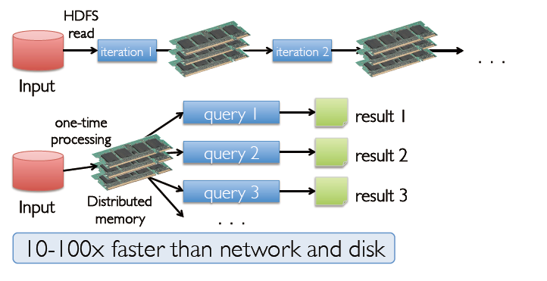
In-Memory Data Sharing

Slide 27
Resilient Distributed Datasets (RDDs)
Write programs in terms of operations on distributed datasets
Partitioned collections of objects spread across a cluster, stored in memory or on disk
RDDs built and manipulated through a diverse set of parallel transformations (map, filter, join) and actions (count, collect, save)
RDDs automatically rebuilt on machine failure

Slide 28
The Spark Computing Framework
Provides programming abstraction and parallel runtime to hide complexities of fault-tolerance and slow machines"
“Here’s an operation, run it on all of the data”"
I don’t care where it runs (you schedule that)
In fact, feel free to run it twice on different nodes

Slide 29
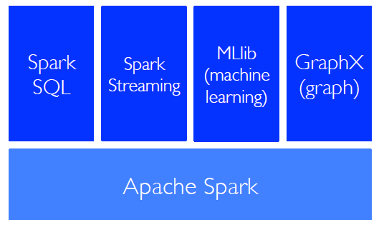
Spark Tools

Slide 30
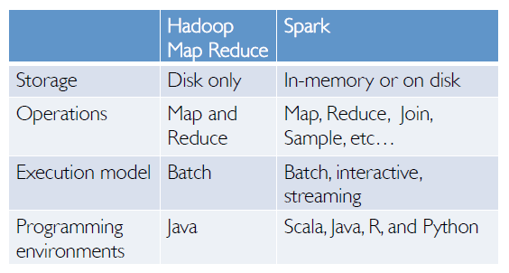
Spark and Map Reduce Differences

Slide 31
Other Spark and Map Reduce Differences
Generalized patterns
unified engine for many use cases
Lazy evaluation of the lineage graph
reduces wait states, better pipelining
Lower overhead for starting jobs
Less expensive shuffles

Slide 32
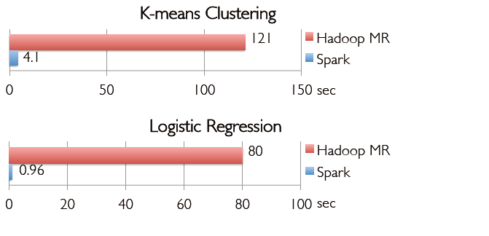
In-Memory Can Make a Big Difference
Two iterative Machine Learning algorithms:

Slide 33
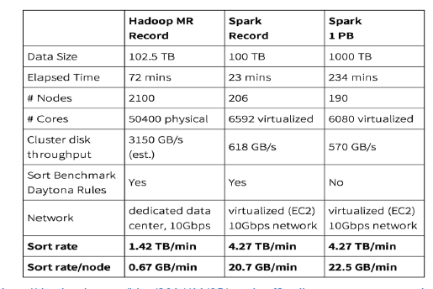
First Public Cloud Petabyte Sort

Slide 34
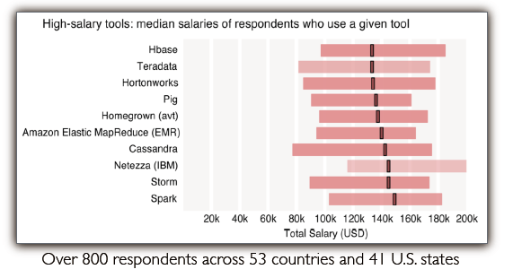
Spark Expertise Tops Big Data Median Salaries

Slide 35
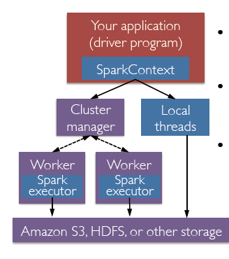
Spark Driver and Workers
A Spark program is two programs:
=>A driver program and a workers program
Worker programs run on cluster nodes or in local threads
RDDs are distributed across workers

Slide 36
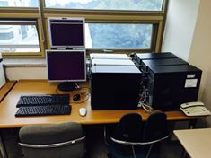
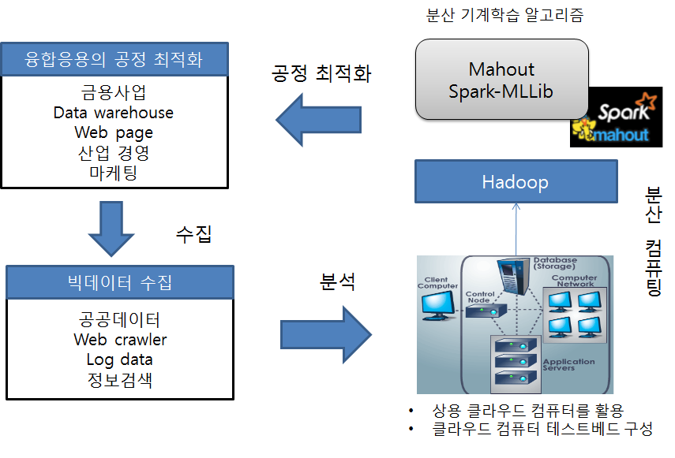
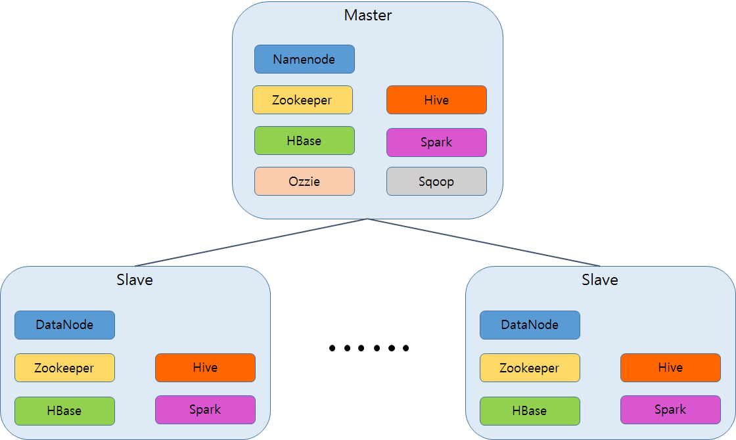
Our system setting

Slide 37
Ambari setting for Spark

Slide 38
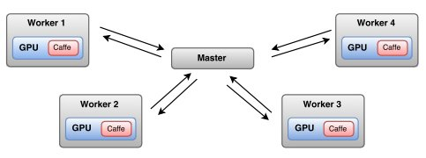

Spark + Deep Learning
Distributed Deep Neural Network Training with SparkNet

Slide 39
Conclusion
Rapid growth of massive datasets
Data Analytics
What tool?
Distributed file system: Hadoop Ecosystem
The Spark Computing Framework
Spark + Deep Learning

Slide 40
The End
Thank you.

